Slide 1
@Open-Ones Group
How To Do Coding?
Duration: 60'
Presenter: Open-Ones Group
Nguyễn Xuân Doãn
Notes:
Version 1.1:
+ Update slide: Flow of stages/phages in SDLC
+ Update Referrence:
Software Handbook of Open-Ones Group

Slide 2
Objectives
Understand about the importance of coding follow coding standards.
Understand about the methods/tools that make sure your code complies with coding standards.
Know about some common errors in coding.

Slide 3
Content
What is coding?
Methods/tools to improve your code
Summarize

Slide 4
How To Do Coding?
Coding, in computer terms, is the process of writing, assembling, and compiling computer code. Code is simply the instructions for hardware and software. HTML is a kind of computer code or language that you can use to create your own web pages.

Slide 5
How To Do Coding?
Don't write the same code twice.
Let think about the future of your program when developing it.
The less code you write, the less error you make.
You will never become an expert coder if you code less than 2 hours per day.
Programmers to use most of their time to fix. Program easier to read much more time saving much.
School makes you believe that your program only have to meet you alone is enough. This is completely wrong. Program must satisfy customers and other programmers.
(Internet)

Slide 6
How To Do Coding?
Follow code convention rules.
Apply tools to check coding standards.
Review your code.
Work-based experience.

Slide 7
How To Do Coding?
Code convention rules are important to programmers for a number of reasons:
  80% of the lifetime cost of a piece of software goes to maintenance.
  Hardly any software is maintained for its whole life by the original author.
  Code conventions improve the readability of the software, allowing engineers to understand new code more quickly and thoroughly.
For the conventions to work, every person writing software must conform to the code conventions. Everyone.
(Java Code Conventions)

Slide 8
How To Do Coding?
if (booleanExpression) {
return true;
} else {
return false;
}
e = (a=b+c)+d
if (a == b && c == d)
if (condition) {
return x;
}
return y;
int foo, fooarray[];
Class.forName("com.mysql.jdbc.Driver");
conn = DriverManager.getConnection(url,"root",“root");
if ( xx > 5) {
System.out.println(“test:”+xx);
…
}
int aaaaa = 5;
int bb = 7;
if( cc < 2) {…}

Slide 9
How to do Coding?
Apply tools:
  Nowadays, with the help of format code function in the common IDEs such as Visual Studio/Eclipse/Netbean (and most current programming editors), they help us to cover about 80% of the coding convention rules.
  The rest 20%, mainly focus on naming convention, we must take care manually by ourselves.

Slide 10
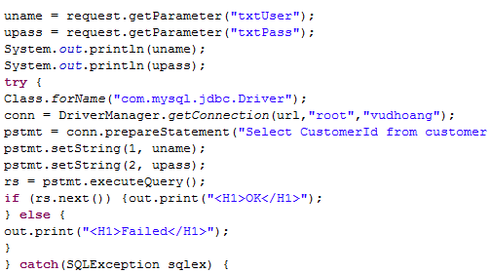
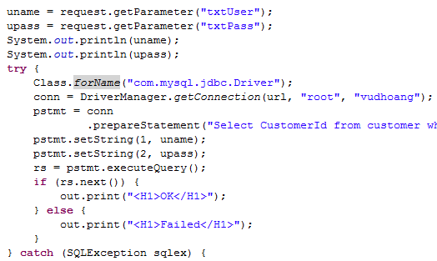
How to do Coding?
Apply tools (cont):
Eclipse: Ctrl Shift F
Netbean: Alt Shift F
Visual Studio: Ctrl K D or Ctrl K F

Slide 11
How To Do Coding?
if(qName.equals("user")){
count++;
}
System.out.println(qName);
int length =attributes.getLength();
for(int i=0; i<length; i++){
System.out.println("there are " + length + " attribute in tag " + qName);
System.out.println("value: " + attributes.getValue(i));
}
// check qName
if (qName.equals("user")) {
// increase count value
count++;
}
// print qName
System.out.println(qName);
// get the length of attributes
int length = attributes.getLength();
// loop through the attributes and print its value
for (int i = 0; i < length; i++) {
System.out.println("there are " + length + " attribute in tag "
+ qName);
System.out.println("value: " + attributes.getValue(i));
}

Slide 12
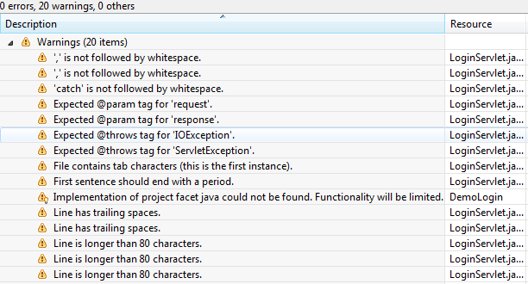
How to do Coding?
Apply tools (cont.):
  Checkstyle (http://checkstyle.sourceforge.net)
    Help programmers write Java code that adheres to a coding standard.

Slide 13
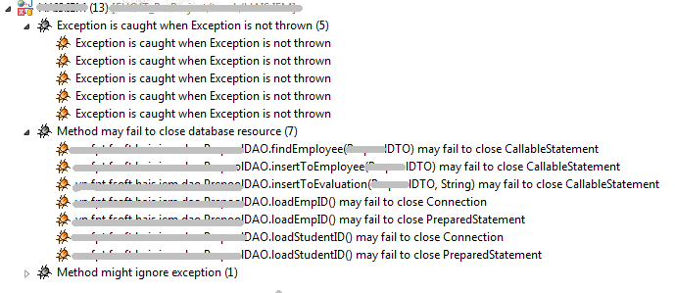
How to do Coding?
Apply tools (cont.):
  Findbugs (http://findbugs.sourceforge.net)
    Uses static analysis to look for bugs in Java code.

Slide 14
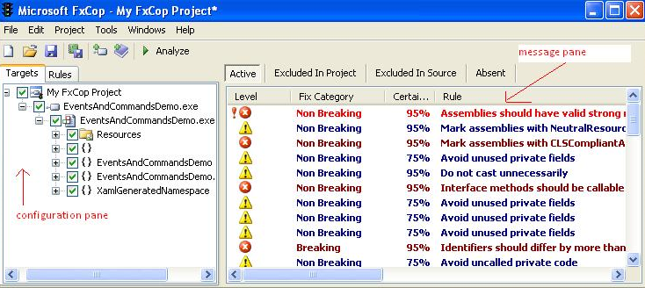
How to do Coding?
Apply tools (cont.):
  FxCorp (http://findbugs.sourceforge.net)
    FxCop is a free static code analysis tool from Microsoft that checks .NET managed code assemblies for conformance to Microsoft's .NET Framework Design Guidelines.

Slide 15


How to do Coding?
Apply tools (cont.):
  Version-control tools:

Slide 16
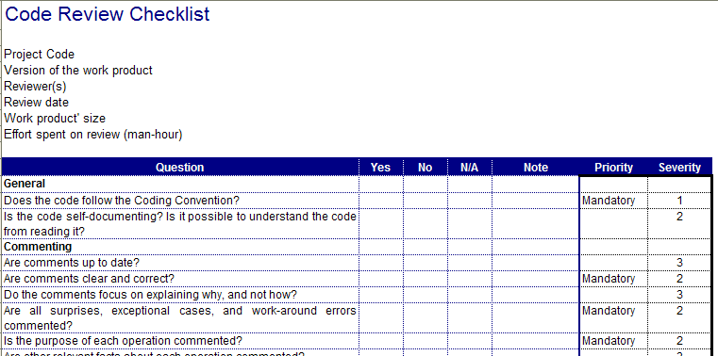
How To Do Coding?
Review your code:
  Apply checklist for work product.

Slide 17
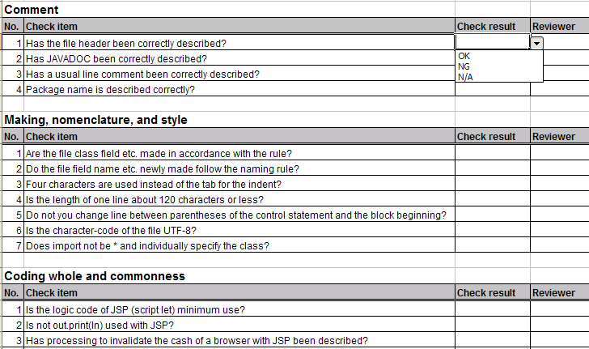
How to do Coding?
Review your code (cont.):
  The checklist is applied for each source code file.
Sample of checklist that is extracted from the Java Code Convention.

Slide 18
How to do Coding?
Review your code (cont.):
  Peer code review
    Is conducted after you sure that your code is completed, tested and ready for the next step.
    Help code is inspected to identify possible improvements and ensure that business requirements are met.
    Gives us a different perspective. “Another set of eyes” adds objectivity. Similar to the reason for separating your coding and testing teams, peer reviews provide the distance needed to recognize problems. (Guide to peer reviews)

Slide 19
How to do Coding?
Work-based experience:
  Warning in coding:
  Copy & paste source code from other is a bad habit.
  Don’t copy code from another program unless you have permission or the license permit it, like Open Source license.

Slide 20
How to do Coding?
Work-based experience (cont.):
  Some common errors:
    Hard code constant
-Give a fixed value when you format data, for example:
dgrView.PageSize = 10;
-Fixed error message in code
strErr = "Error message here";
-The problem occurs when you should change these values. If you put them in the constant/property files, you need change only one time, if you fixed them, you'll be find and change anywhere you have the fix value.

Slide 21
How to do Coding?
Work-based experience (cont.):
  Some common errors:
    Declare variable in loop
for (int i=0; i<lstStudent.size();i++){
StudentDTO dto = new StudentDTO();
dto.setName(lstStudent[i][0]);
dto.setAge(lstStudent[i][1]);
…
result.add(dto);
}

Slide 22
How to do Coding?
Work-based experience (cont.):
  Some common errors:
    Combine function calling and passing parameters as the same time
Should assign the returned value of the called function to a temp variable instead of pass it directly to the calling function, for example, instead of:
a = func1(func2(func3, func4));
you can use three temp variables:
b=func(3);
c=func(4);
d=fun2(b,c);
a=fun1(d);
When you use the temp variable, the code are clearly, and you can avoid the long line same as:
strReturn = objDoc.SelectNodes(objNode.Attributes(objAttr.ChildNodes.Item(0).ToString()));

Slide 23
How to do Coding?
Work-based experience (cont.):
  Some common errors:
    Lack of checking for null value, espcially with the request data.

Slide 24
How to do Coding?
Work-based experience (cont.):
  Some common errors:
    Use equals() when comparing String datatype
Instead of:
if (strName.equals(Constants.DEFAULT_NAME)) {…}
you should use as below (to avoid the exception in case strName is null value):
if (Constants.DEFAULT_NAME).equals(strName) {…}

Slide 25
How to do Coding?
Work-based experience (cont.):
  Some common errors:
    Code can not be tested
try {
\\ CODE BLOCK HERE
} catch (Exception) {
\\ DO NOTHING
}

Slide 26
How to do Coding?
Work-based experience (cont.):
  Some common errors:
public bool IsValidLogin(string userName, string password) {
SqlConnection con = null;
SqlCommand cmd = null;
bool result = false;
try {
con = new SqlConnection(DB_CONNECTION);
con.Open();
string cmdtext = string.Format("SELECT * FROM [Users] WHERE [Account]='{0}' AND [Password]='{1}' “, userName, password);
cmd = new SqlCommand(cmdtext);
cmd.Connection = con;
cmd.CommandType = CommandType.Text;
result= cmd.ExecuteReader().HasRows;
cmd.Dispose();
con.Dispose();
return result;
} catch (SqlException) {
return false;
}
}
Lack of checking for null value
SQL Injection
SQL Performance Issue !!
Memory leak !!

Slide 27
How To Do Coding?
Follow code convention rules.
Apply tools to check coding standards.
Review your code.
Work-based experience.

Slide 28
References
Public FPT Software's CMMi documents
http://ict-industry.gov.vn/Clients/Document/DownloadDocument.aspx?Me=Document&ID=1
Wiki
http://en.wikipedia.org/wiki/Software_development_process
Guide to Peer Review
http://www.builderau.com.au/program/development/soa/Guide-to-peer-reviews/0,339024626,320266725-2,00.htm
Software Handbook of Open-Ones Group
https://open-ones.googlecode.com/svn/trunk/OOG-Handbook

Slide 29
Discussion

